Slide 1
A Comprehensive Benchmarking for Deep Learning Models in WiFi Sensing
Project guide : Vijay Kumar Singh
Dheeraj(2020194), (Shreyanshu(2020130)

Slide 2
Problem statement
This project aims to benchmark different deep-learning models for WiFi sensing using significant data sets.
The project aims to create and train different deep-learning models.
The aim is to get the benchmarking details of the deep learning models run on four significant datasets.

Slide 3
Expected deliverables
We will perform extensive benchmarking on the models for the given datasets. We will be evaluating the parameters listed below for every model and dataset.
Training accuracy
Testing accuracy
Validation accuracy
Training time
Inference time
Memory requirement for training a particular model
Number of rows
Number of features of training and testing data

Slide 4
Models and datasets used
The Models to be benchmarked include:
BiLSTM
CNN+GRU
ResNET 101
ResNET 50(Extra)
MLP (before midsem)
LeNET (before midsem)
The datasets to be used include:
UT-HAR
Widar 3.0
NTU-FI-HAR
NTU-FI-HumanID

Slide 5
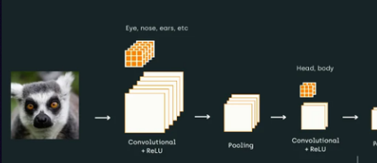
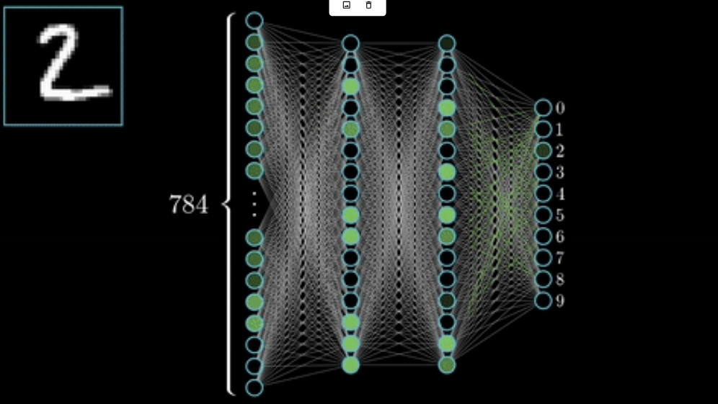
Overview of BILSTM, Resnet CNN+GRU

Slide 6
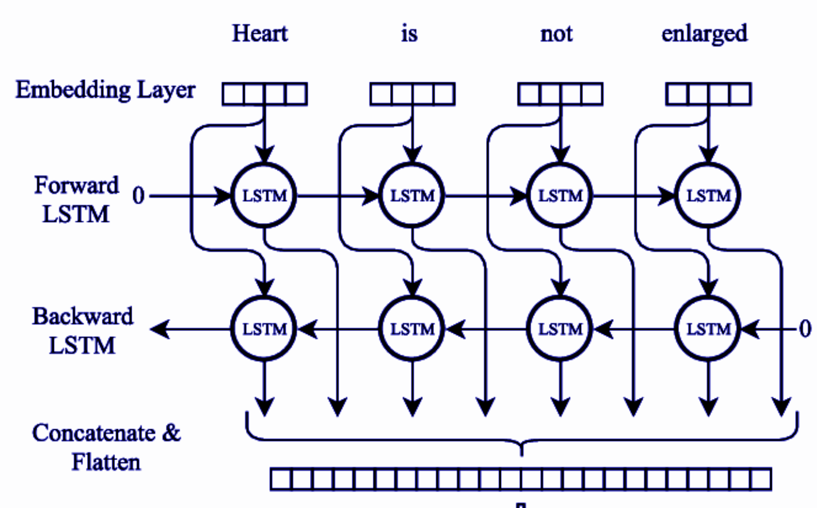
BILSTM Architecture
Definition and purpose of BILSTM
Input and output layers
Hidden layers and their activation functions

Slide 7
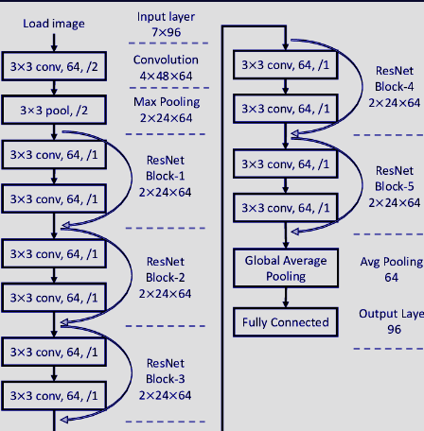
ResNet Architecture
Convolutional layers and their role in ResNet
Pooling and subsampling layers
Residual layer
Fully connected layers and output layer

Slide 8
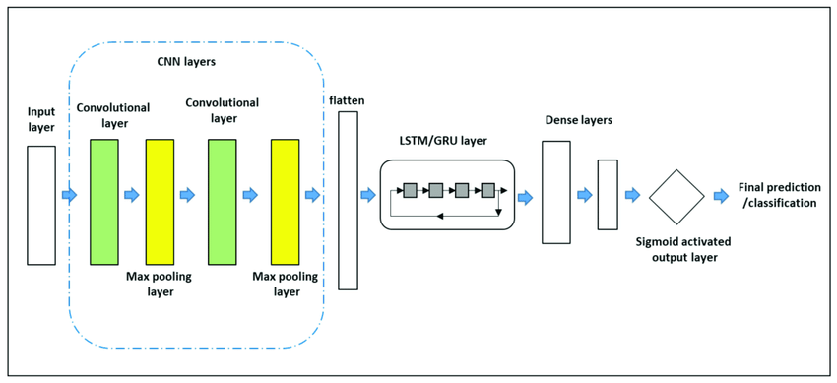
combines the power of convolutional neural networks (CNN) and gated recurrent units (GRU).
CNN +GRU Architecture

Slide 9
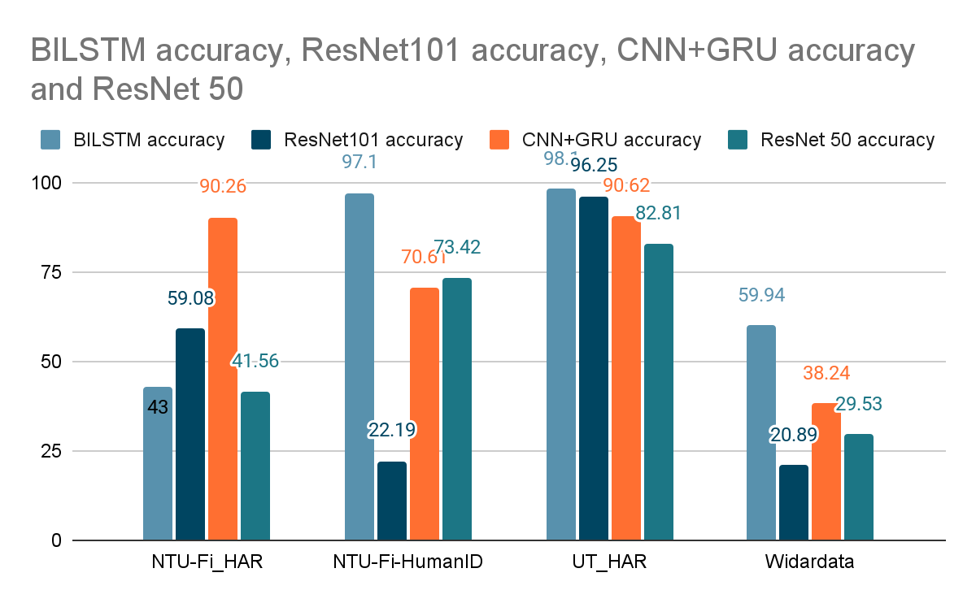
Results of Benchmark
Result are store inside result.txt file and in collab notebook

Slide 10
Insight
Dataset
Model result

Slide 11
Contribution
Dheeraj- Benchmark Implementation + ppt
Shreyanshu- ppt + report

